Slide 1

Minor Programme Overview
Academic Registry
28 October 2026

Slide 2
CONTENTS
01
List of Minor Programmes
02
Fulfilling Minor Programme Requirements
03
Double-counting NOT applicable
04
Application for Graduation with a Minor Programme
05
GPA Requirement for Minor Programme
06
Eligibility for Graduation with a Minor Programme
07
Indication of Completion of Minor Programme

Slide 3
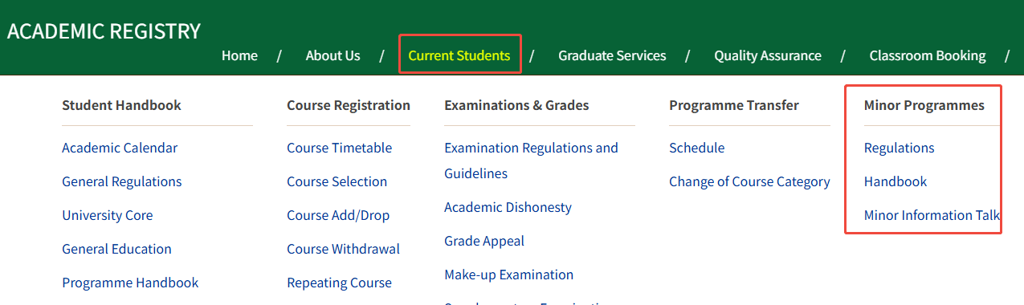

List of Minor Programmes
AR Website: https://ar.bnbu.edu.cn/

Slide 4

Fulfilling Minor Programme Requirements
https://ar.bnbu.edu.cn/current_students/minor_programmes/handbook.htm
副修 ≠ 辅修
Not a second degree
Minor Prog. Courses Requirements:
15 units of Free Elective (FE) courses
Required Course(s)
FE
Minor Handbook
Target Students,
Level 3 or above courses,
Note, etc.
Elective Courses
Units transferred for Minor ≤ 6 units
Summer/Winter Programme and Exchange Programme

Slide 5
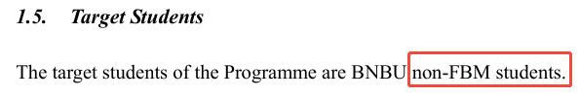
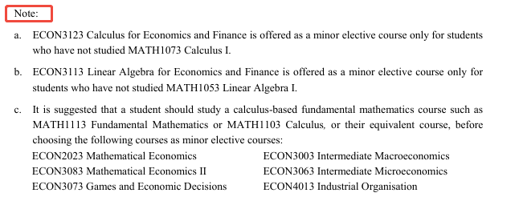
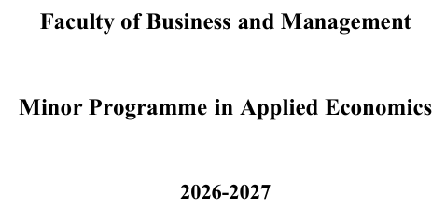
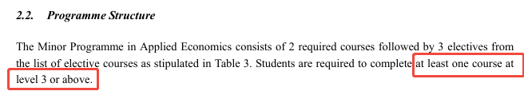
Fulfilling Minor Programme Requirements
Fulfilling Minor Programme Requirements

Slide 6
Fulfilling Minor Programme Requirements
Course Selection
Course Add/Drop
  In July/January each year
At the beginning of each semester
No Guarantee of Places for Minor Courses
Owing to limits on class quota set by Course Offering Units, please note that you will NOT be guaranteed a place for any minor course you wish to take. Successful enrolment on Minor courses is subject to limitations on course quota, class schedule, etc

Slide 7
Double-counting NOT applicable
A course cannot be double-counted as a Major and Minor course at the same time.
Scenario | If a Course is… | Counted Towards | Note
1 | Major Required, and listed under Minor Required/Elective | Major Programme | Units will not be counted towards Minor Programme. Must choose another Minor elective to fulfill Minor unit requirement.
2 | Minor Required, and listed under Major Elective | Minor Programme | Units will not be counted towards Major Programme. Must choose another Major elective to fulfill Major unit requirement.
3 | Minor Elective, and listed under Major Elective | Either Major Programme or Minor Programme | Course may be used to fulfill either Minor or Major unit requirement.

Slide 8
Application for Graduation with a Minor Programme
Students who have successfully accumulated 15 units required by the Minor Programme may apply for graduation with Minor in March of your final year. The Academic Registry will send e-mail to all final year students to invite application for graduation with a Minor Programme in due course.
No prior declaration of intention to take a minor is needed with immediate effect. On the other hand, you are invited to keep us posted of your intention from time to time by filling in “Survey about your Intention to Take a Minor Programme” (https://mis.bnbu.edu.cn/survey/index.do) so that the academic departments can take it as a reference for planning and adjusting course offerings

Slide 9
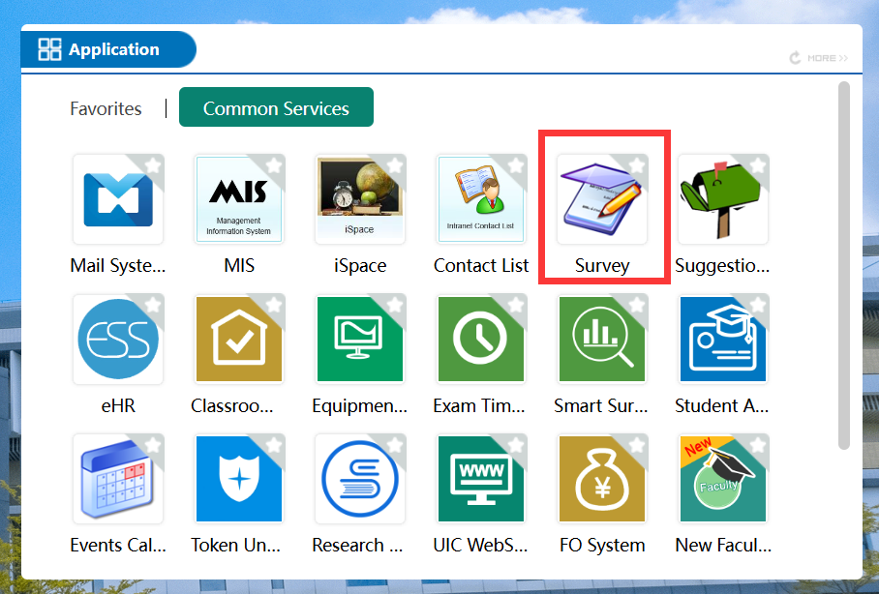
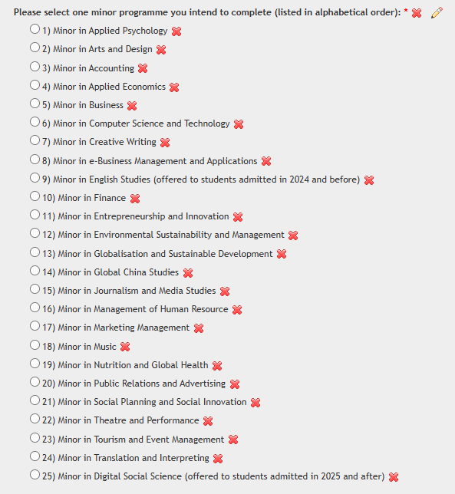
Share your intention with us: complete the Survey via MIS Survey system.
Link: https://mis.bnbu.edu.cn/survey/index.do

Slide 10
GPA Requirement for Minor Programme
There is GPA requirement for the minor programme. A student, in order to graduate with a minor, has to:
☑ fulfil all University general requirements; and
☑ pass all courses required in the major and minor programmes; and
☑ attain a minimum cGPA of 2.0 for all the courses attempted for the minor programme; and
☑ attain a minimum cGPA of 2.0 for all the courses attempted.

Slide 11
Eligibility for Graduation with a Minor Programme
Major Requirements Met | Minor Requirements Met | Outcome | Study Period Extension | Example Scenario
Yes | No | Major degree only | Not allowed | Student completes all major courses but falls short on minor courses, thus can only graduate with a major degree and no extension is granted.
No | Yes | Cannot graduate with Minor only | -- | Student completes minor courses but fails to complete major courses; student has to meet major programme requirement.

Slide 12
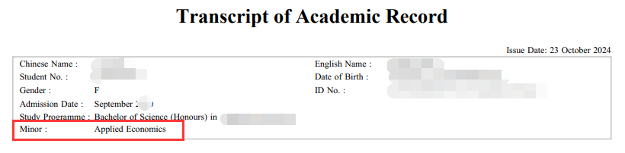
Indication of Completion of Minor Programme
NO certificate will be issued by the University for Minor programme(s)
The completed Minor will be recorded on the academic transcript only.

Slide 13
Tips
Pay attention to AR website – Minor Programmes
Check BNBU email account on a regular basis
Meet all Deadlines
Contact AR
Ms. Josey JIAO
academicsuccess@bnbu.edu.cn
0756-3620832

Slide 14
Thank you~

